Slide 1

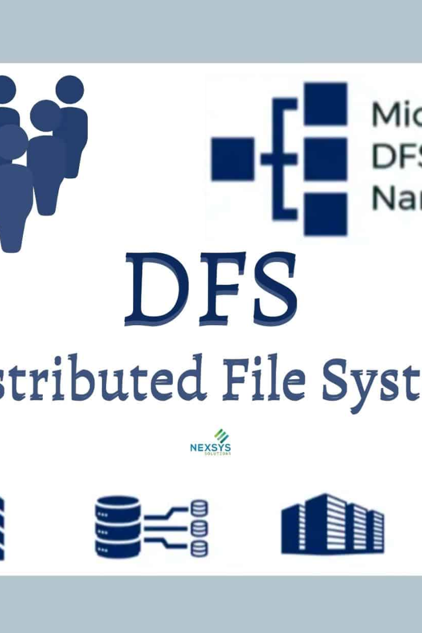

Directory Commands
The file system commands provide essential functions for managing directories and files. In this presentation, we will explore five key commands and functions that are commonly used in the file system. Let's dive in!

Slide 2
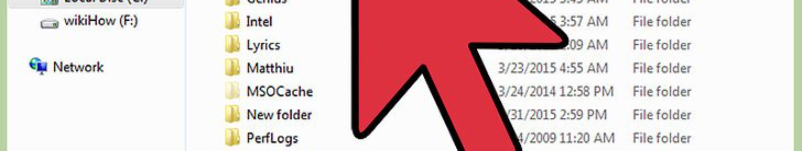
mkdir (Make Directory)
The mkdir command allows you to create new directories (folders) in a file system. Simply specify the name of the directory you want to create, and the command will create it for you.
Usage: mkdir directory_name

Slide 3
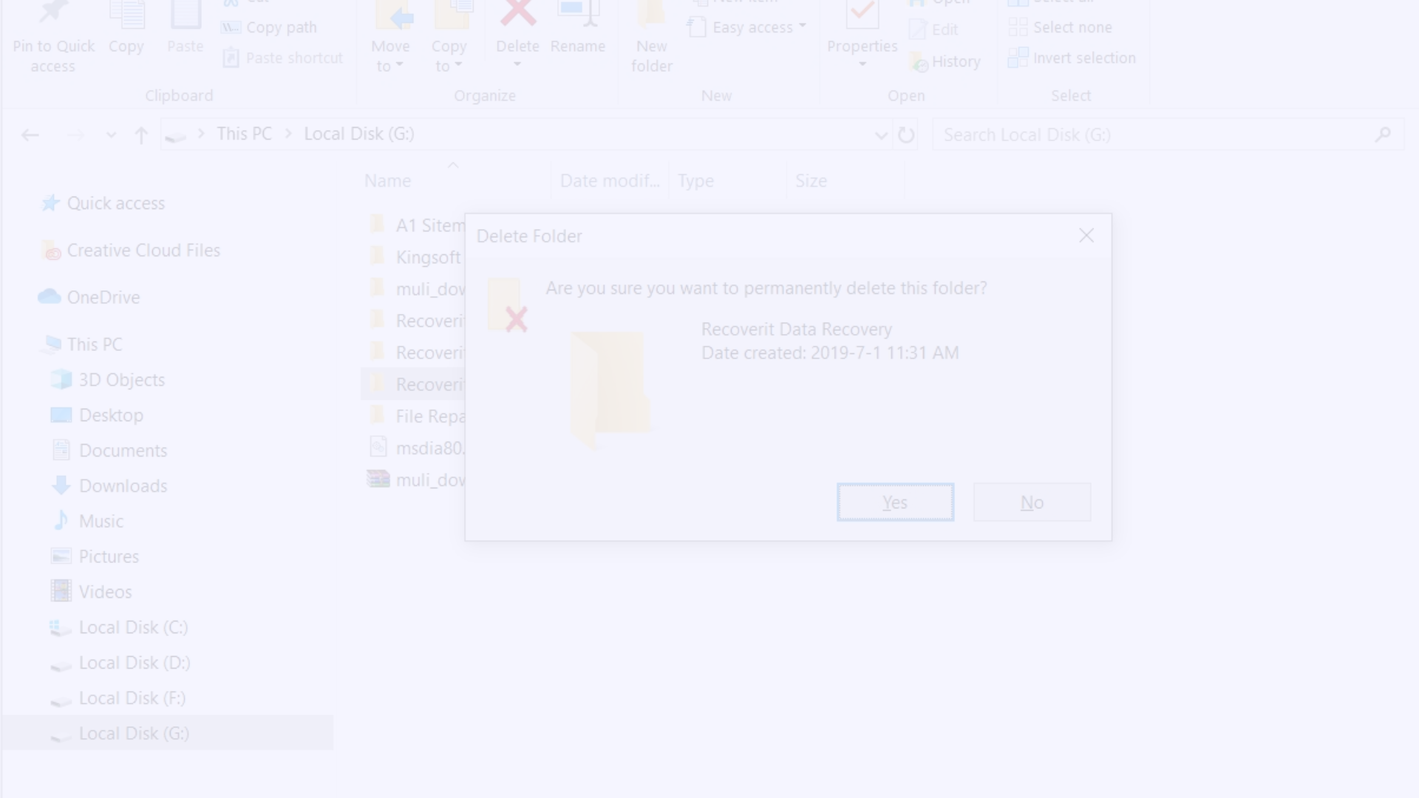
rmdir (Remove Directory)
The rmdir command is used to remove directories from a file system. However, please note that the directory must be empty in order for the rmdir command to work. Take caution when using this command to avoid accidental deletion of important files.
Usage: rmdir directory_name

Slide 4
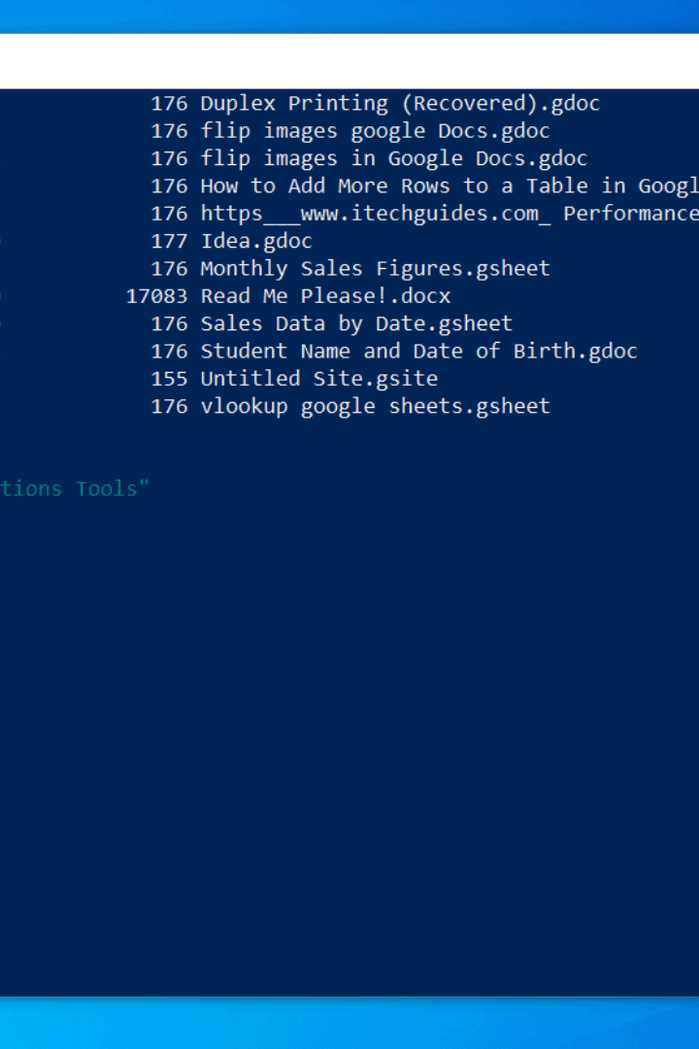
chdir (Change Directory)
The chdir command, also known as cd, is a command used to change the current working directory in a shell or terminal session. It allows you to navigate through the directory structure and switch to a different directory.
Usage: cd directory_path

Slide 5
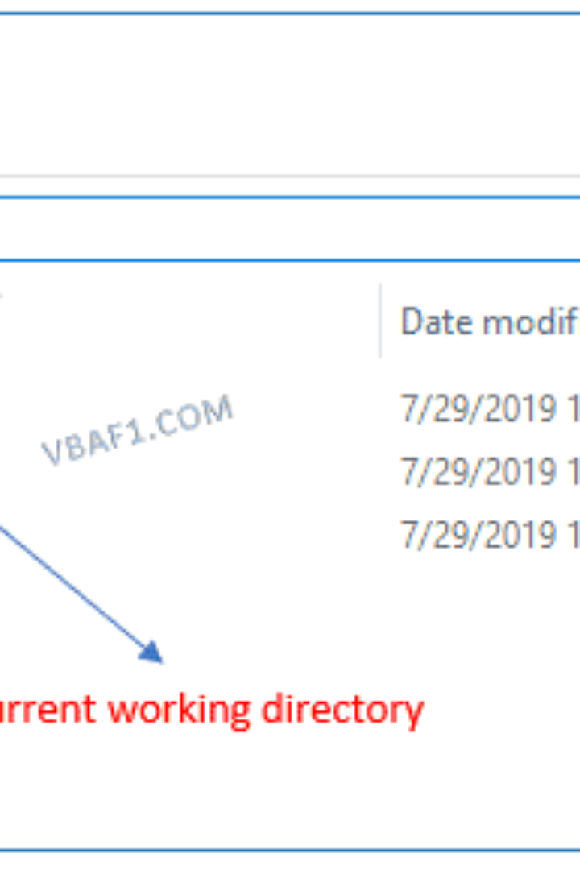
getcwd (Get Current Working Directory)
The getcwd function retrieves the current working directory of a process. It is often used in programming to determine the current directory path and perform further operations based on the location of the program or files.
Usage (in C programming): getcwd(buffer, size)

Slide 6

opendir (Open Directory)
The opendir function is a useful tool in programming that allows you to open and access the contents of a directory. It's typically used in combination with other directory-related functions to read or manipulate files within a directory.
Usage (in C programming): opendir(directory_path)

Slide 7
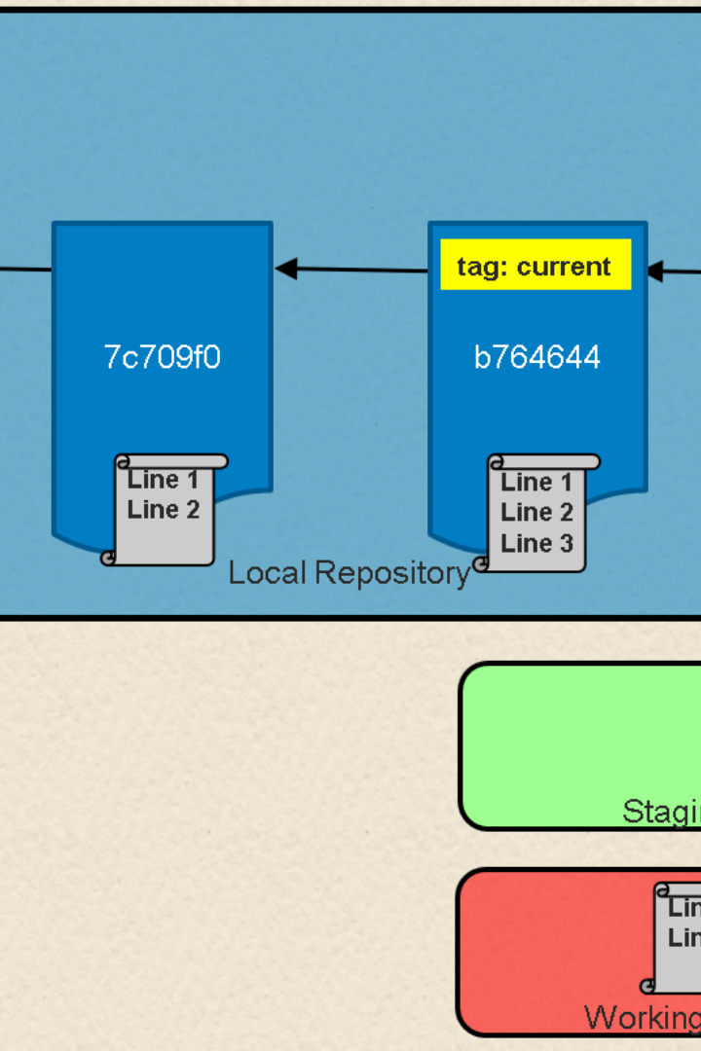
rewind
The rewind function is a C library function used in file handling to reset the file position indicator to the beginning of a file. It is often used when you need to re-read a file from the start or perform multiple reads without closing and reopening the file.
Usage (in C programming): rewind(file_pointer)

Slide 8
Putting It All Together
Efficient Directory Management
Increased Productivity
Mastering File Management
By using the mkdir, rmdir, chdir, and opendir commands alongside the getcwd function and rewind function, developers can create, navigate, and manipulate directories and files efficiently.
With a solid understanding of these file system commands and functions, you can streamline your file operations, enhancing your productivity and allowing for more organized and manageable projects.
Practice and experimentation are key to becoming proficient with these commands and functions. Keep exploring and honing your file management skills to become a seasoned developer.

Slide 9
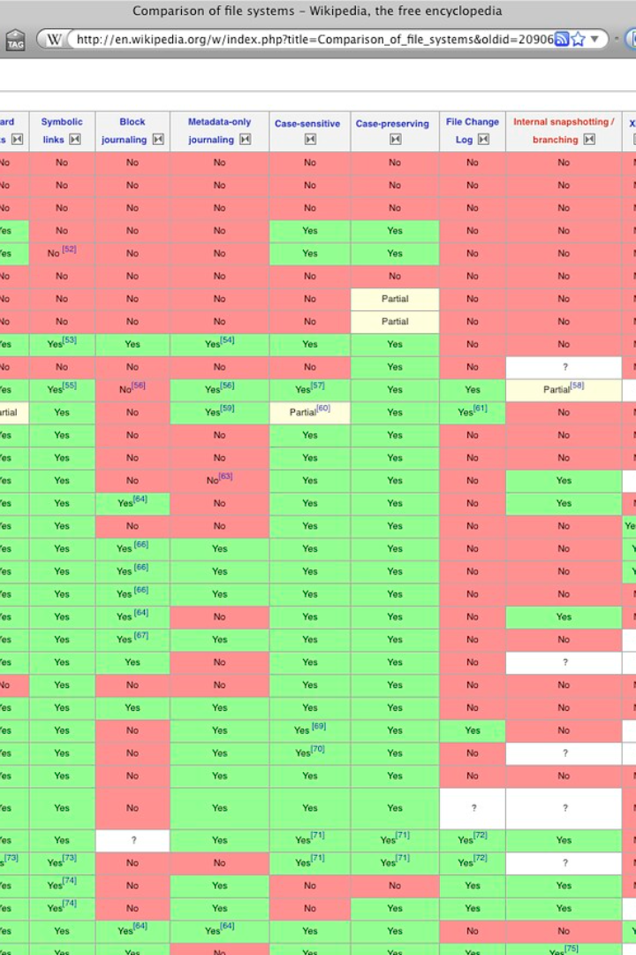
Conclusion
In summary, understanding and utilizing file system commands and functions is crucial for effective file and directory management. Whether you are navigating directories, creating new folders, or manipulating files, these commands will empower you with the necessary tools to streamline your workflow and increase productivity.

